Slide 1
Soar Technology Company Update

Slide 2
Enhancing human performance
Intelligent Training
Unmanned Platforms
Decision Support

Slide 3
Technology Innovation
Autonomy
Adaptation
Human/System Interface

Slide 4
Enhancing × Technology Innovation
Intelligent Training
Unmanned Platforms
Decision Support
Autonomy
Adaptation
Human/System Interface

Slide 5
Enhancing × Technology Innovation × Domains
Intelligent Training
Unmanned Platforms
Decision Support
Aviation
Autonomy
Adaptation
Human/System Interface

Slide 6
Enhancing × Technology Innovation × Domains
Intelligent Training
Unmanned Platforms
Decision Support
Aviation
Infantry
Autonomy
Adaptation
Human/System Interface

Slide 7
Enhancing × Technology Innovation × Domains
Intelligent Training
Unmanned Platforms
Decision Support
Aviation
Infantry
Autonomy
Navy
Social, Cultural
Commercial Auto
Medical
Adaptation
Human/System Interface

Slide 8
Enhancing × Technology Innovation × Domains
Intelligent Training
Unmanned Platforms
Decision Support
Aviation
Infantry
Autonomy
Navy
Social, Cultural
Commercial Auto
Medical
Cyber Security
Adaptation
Human/System Interface

Slide 9
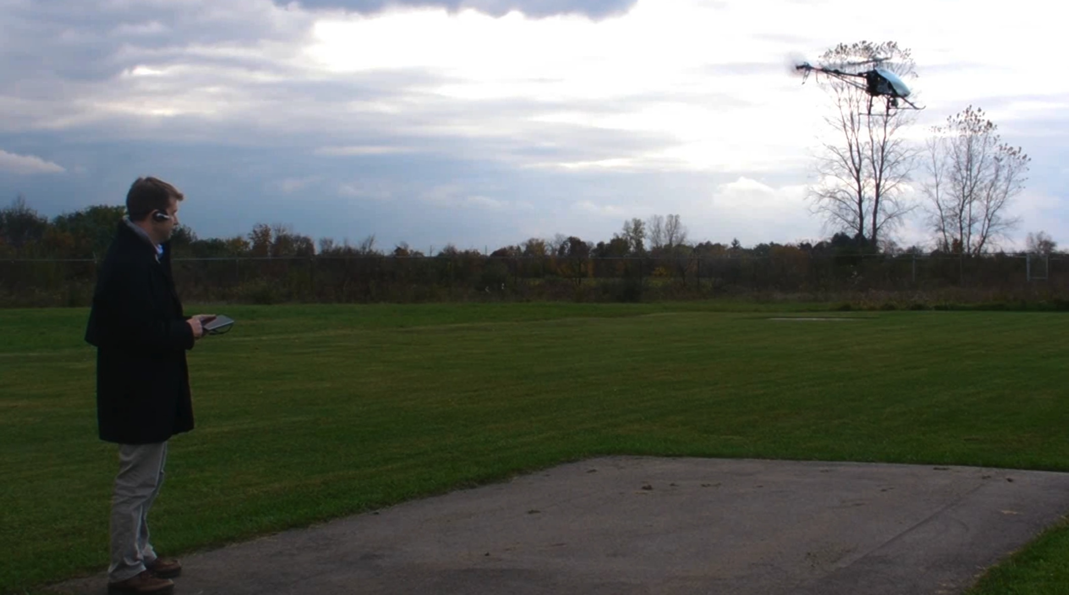
SID and STX-1 video

Slide 10
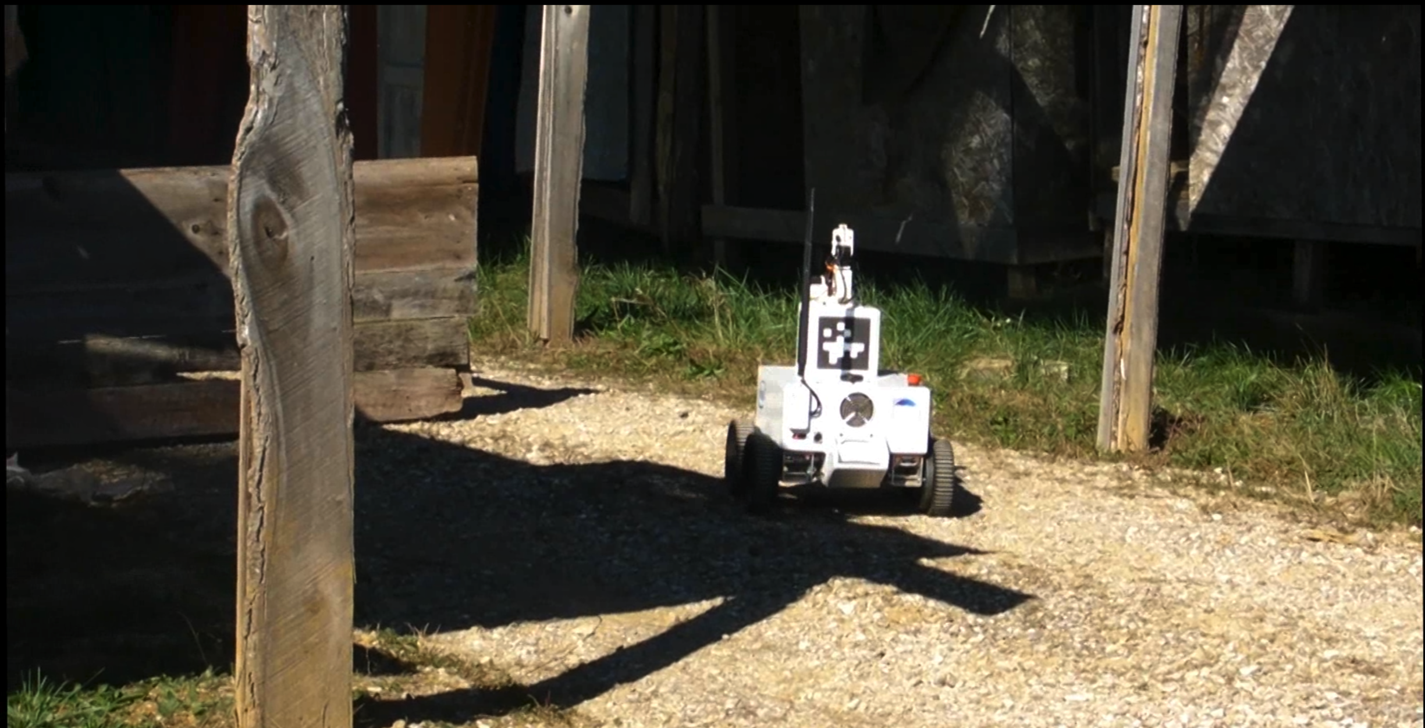
SID IROC video

Slide 11
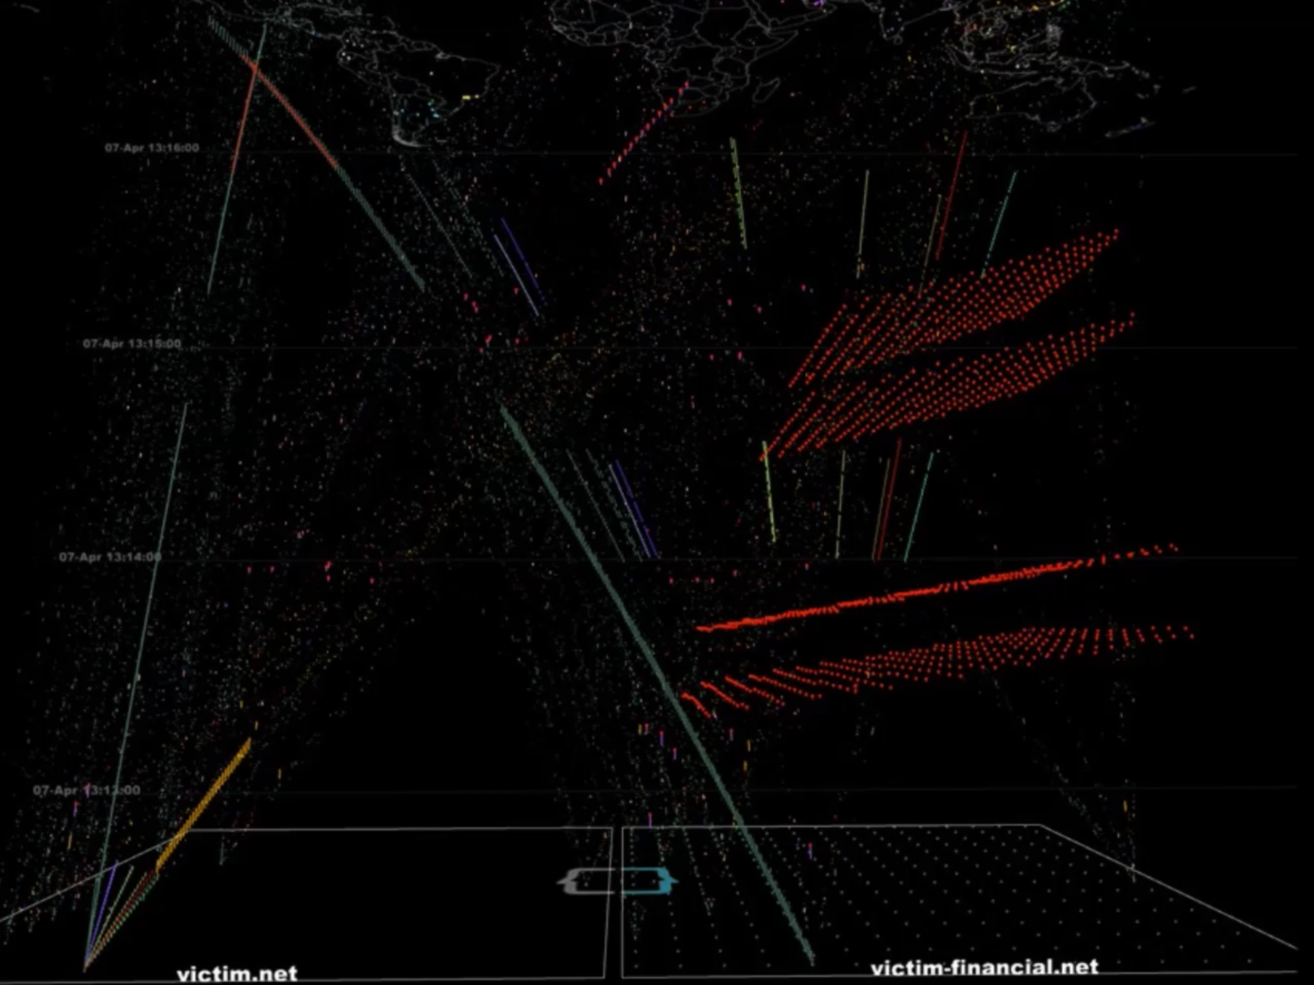
SC2RAM video

Slide 12
Contributions to the Soar community
jSoar
jSoar 0.14.3 released this morning
See Bob Marinier’s talk this morning
SoarIDE
Re-engaging in supporting and extending the SoarIDE
See Bob Marinier’s talk this morning
Soar Programmer’s Guide
Captures lessons learned in developing Soar agents
See Bob Marinier’s talk this morning

Slide 13
Nuggets and Coal
Nuggets
Gaining momentum in applying Soar (and other AI technologies) to cybersecurity
Back on a growth trajectory after weathering the storm of sequestration
At least 7 consecutive years of profitability
Exploring commercialization of Soar-based technologies
Exciting new office location in Orlando
Nugget and Coal
Emergence of competimates proposing Soar-based solutions to the DoD
Coal
Significant competition in hiring AI researchers
Significant competition in retaining senior software engineers

